Slide 1

EC500 E1: Parallel Programming and HPC
Parallelizing 2D Convolutions on GPUs
Group 1: Michael Clifford, Patrick Dillon, Frank Tranghese

Slide 2
Outline
Introduction - What Is a Convolution and Why is it important
Work Planned vs Work Accomplished
Parallelization Strategy
Results
Road Blocks
Time Complexity
Memory Issues
Lessons Learned
Next Steps
Conclusion

Slide 3
Goal
The goal of our project is to work with 2D convolution, a widely-used and simple, yet computationally inefficient algorithm, and explore methods to speed it up by implementing parallelization with GPU’s

Slide 4
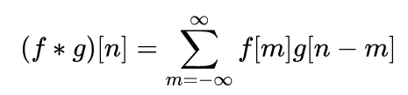
What is a Convolution?
A 1D convolution is a linear combination of two functions: f, some signal that you have recorded and g, a filter to process the signal data in some desired fashion (i.e. smoothing, edge detection, or lowpass). You can extend the convolution into 2, 3, … N dimension. Convolution is a common data processing method that is used in a wide variety of domains.
The 2D convolution has a worst case time complexity of O(n⁴). So finding methods to improve performance is key.
Image from Wikipedia

Slide 5
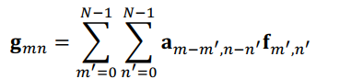
The 2D Convolution Example
2D convolutions generate new representations of the original data matrix based on a linear combination of its elements with that of a filter matrix or “Kernel” as it moves through the original data.
One relevant reason for exploring parallelizing this operation is its wide use in modern computer vision and current deep learning applications.

Slide 6
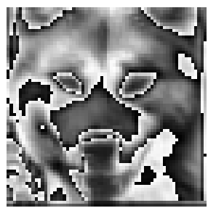

The 2D Convolution Example
Example of using our 2D convolution function for edge detection on a 64x64 grayscale image of a dogs using a 3x3 local filter.
64x64 grayscale input image
64x64 edge detection output image

Slide 7
Work Planned vs Work Accomplished
Build the 2D convolution function, FFT and the resulting matrices in both serial and parallel fashion
Building the 2D convolution matrix follows a specific pattern and can be parallelized
Reshaping the image, performing matrix math, and reshaping back to original size are all also parallelizable operations.
Compare direct convolution to FFT2
Parallelize FFT
Test both parallelized methods and compare/contrast for different inputs (different sized images and kernels)
Use OpenACC for GPU parallelization
Use OpenACC on the SCC

Slide 8
Work Planned vs Work Accomplished
Built 2D convolution functions in C++
Built Circulant Matrix Variant
Built Direct Variant
Built 2D FFT method for comparison
Used built-in image libraries for reading images
Built function to generate 2D black and white noise images to test scaling
Parallelized code for Direct Variant
Compared direct variant with multiple compiling methods on SCC
Serial, Multicore CPU and GPU
Required porting much of the code from C++ to C.
Used OpenACC for GPU and parallelization
Use OpenACC on the SCC

Slide 9

Parallelization Strategy
Initial strategy looked to parallelize each helper function required to perform the entire convolution as well as the convolution function itself
Generating the Circulant Matrix
Converting 2D matrices into 1D Vectors
Generating Images and Filters to Convolve
The main convolution function

Slide 10
Parallelization Strategy
The convolution operation is highly parallelizable due to each step in the algorithm being independent of the rest.
Each KxK block can be computed correctly without information from any of the others.
Our plan was to compute all KxK blocks simultaneously using the openACC library

Slide 11
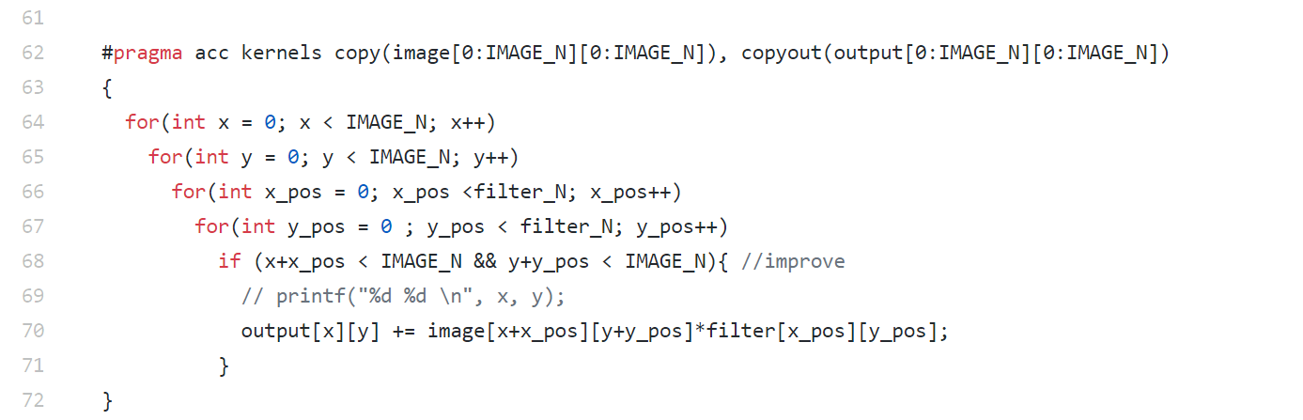
Parallelization Strategy

Slide 12
Parallelization Strategy
Each KxK block is run in parallel

Slide 13
Parallelization with OpenACC
pgcc -DUSE_DOUBLE -Minfo=accel -fast -acc -ta=tesla:cc20 -c main.c -g main: 62, Generating implicit copyin(filter[:][:]) Generating copyout(output[:][:]) Generating copy(image[:][:]) 64, Loop is parallelizable 65, Loop is parallelizable 66, Loop carried dependence of output prevents parallelization Loop carried backward dependence of output prevents vectorization 67, Complex loop carried dependence of output prevents parallelization Loop carried dependence of output prevents parallelization Loop carried backward dependence of output prevents vectorization Inner sequential loop scheduled on accelerator Accelerator kernel generated Generating Tesla code 64, #pragma acc loop gang /* blockIdx.y */ 65, #pragma acc loop gang, vector(128) /* blockIdx.x threadIdx.x */ 66, #pragma acc loop seq 67, #pragma acc loop seq

Slide 14
Results
Parallel Code is Faster Than Serial Code! But how much faster, and in what cases?
We ran the following 3 Experiments:
3x3 kernel on grayscale images ranging from 16x16 to 16384x16384
16x16 kernel on grayscale images ranging from 16 x16 to 16384x16384
All-to-All kernel on grayscale images ranging from 16x16 to 1024x1024
We compared the performance of serial code run on a CPU, parallelized multicore CPU and parallelized GPU. All were run in an interactive session on the SCC with 1 GPU.

Slide 15
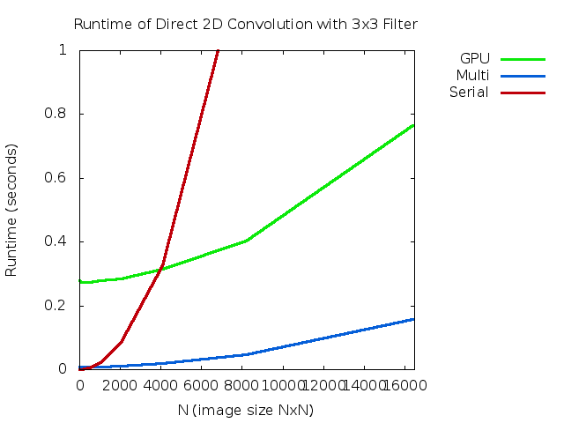
Results: 3x3 Kernel
Due to GPU data passing procedures, the serial code is actually much faster than using a GPU until we reach an image size of around 4000 x 4000 pixels.
Use of GPU has a constant start up time of about ~0.27 seconds. Making it slower than serial code for small convolutions.
Without any data passing overhead multi-core achieves by far the best performance here.

Slide 16
Results: 3x3 Kernel
Endpoint Performance (16384 pix):
GPU: 0.7649 seconds
Multi: 0.1583 seconds
Serial: 4.3467 seconds
With these dimensions GPU is approximately 5.6 times faster and Multi-core is about 27.4 times faster.

Slide 17
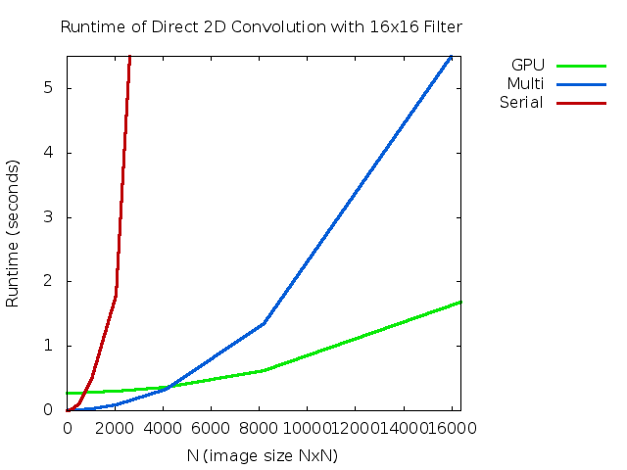
Results: 16x16 Kernel
With a larger kernel,however, we see the benefits of using the GPU much earlier. Around 1024 x 1024.
Although GPU still has constant overhead with smaller matrices, we can see that it vastly outperforms both Serial and Multi-core processing for larger operations.

Slide 18
Results: 16x16 Kernel
Endpoint Performance (16384 pix):
GPU: 1.6843 seconds
Multi: 5.7168 seconds
Serial: 102.6549 seconds
With these dimensions GPU is approximately 60.9 times faster and Multi-core is about 17.95 times faster.

Slide 19
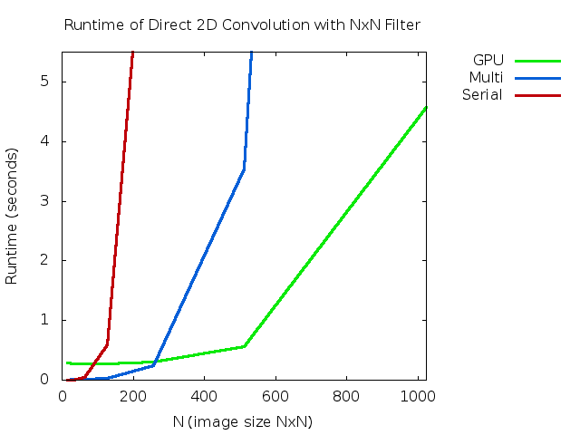
Results: NxN Kernel
All-to-All convolutions require large amounts of memory. Only ran these to 1024 x 1024
These were guaranteed to provide us with worst case running time for each method

Slide 20
Results: NxN Kernel
Endpoint Performance (1024 pix):
GPU: 4.5761 seconds
Multi: 54.7941seconds
Serial: 2347.54 seconds
With these dimensions GPU is approximately 513 times faster and Multi-core is about 42.84 times faster.

Slide 21
A Closer Look at GPU Timing
Set the PGI_ACC_TIME environment variable to receive detailed timing info regarding GPU: Accelerator Kernel Timing data
main NVIDIA devicenum=0
time(us): 625,121
62: compute region reached 1 time
67: kernel launched 1 time
grid: [128x256] block: [128]
device time(us): total=117,676 max=117,676 min=117,676 avg=117,676
elapsed time(us): total=117,736 max=117,736 min=117,736 avg=117,736
62: data region reached 4 times
62: data copyin transfers: 65
device time(us): total=179,962 max=2,820 min=8 avg=2,768
81: data copyout transfers: 130
device time(us): total=327,483 max=2,605 min=25 avg=2,519

Slide 22
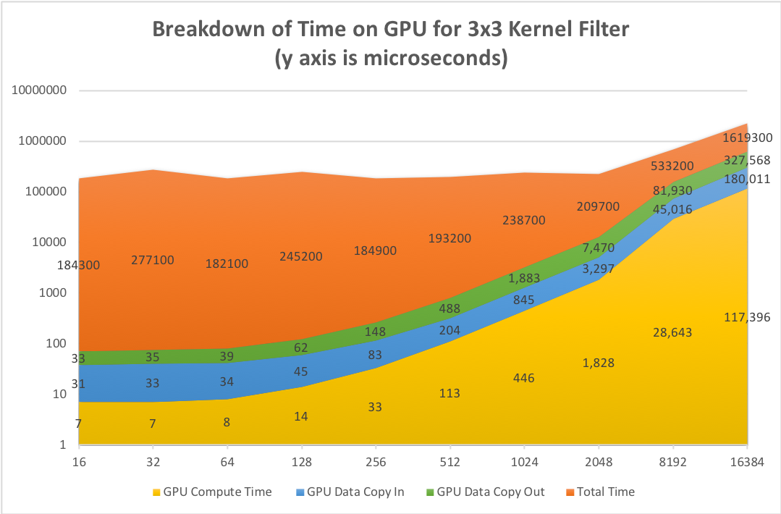

Slide 23
Road Blocks: PGCC compiler on SCC
Initial code was in C++ and used the CImg library
Unfortunately could not compile on PGCC
PGCC has dependence on GCC and referenced GCC 4.4. Attempted fixes:
Switching between Evan’s PGCC install and SCC install
Changing localrc files to point to newer version
We gave up on getting existing code and rewrote
Removed any dependencies for GCC > 4.4 in both a C and a C++ version

Slide 24
Road Blocks: PGCC compiler on SCC
In C++ we had to remove image library. Attempted hacks:
Separating into different files and using different compilers
Compiling as a library and linking
This should be possible, but became a distraction
C we used lodepng library but abandoned it because of difficulty debugging
Went with C version because it was easier to locate parallelization

Slide 25
Road Blocks: Memory Issues
Memory Issues:
Initial circular convolution method required massive memory overhead to store secondary matrices. Memory needs became untenable at around 512 x 512 pixel images. At this point we switched to the direct convolution method.
Despite modified approach, unless a reasonably sized local kernel was used, memory issues remained.

Slide 26
Lessons Learned
In real-world applications, memory bandwidth can be as important (if not more so) than computational complexity. We quickly ran into memory allocation issues that we had not originally considered when focusing solely on parallelizing the computations.
OpenACC is an extremely powerful tool that can generate orders of magnitude speedups with a single line of code.

Slide 27
Future Work
Parallelize FFT and compare performance on similar tests.
Implement image reading function and use more interesting filters
Create matrices on GPU to minimize data movement (this would only work for certain kinds of matrices--not images)

Slide 28
Conclusion
GPU’s can be expensive to initialize and so provide little benefit on smaller tasks. However the economy of scale quickly becomes realized (1024 x 1024 convolution runs over 500x faster than serial variant!)
OpenACC is amazing (once you get it working)
Despite GPU’s massive speed up at larger scales, more work is needed to intelligently manage data allocation and movement.

Slide 29
THANKS!

